Slide 1


Hostel
Management
system
Team Members:
Mumtaz Ali
Muhammad Maaz Muhammad Abubakar
Supervision by: Dr Sarwar Shah Saib.

Slide 2
Introduction
Hostel and Mess Management System simplifies hostel and mess operations.
Features include:
Room allocation.
Complaint management system.
Ensures efficient management.
Biometric attendance.
Online payment integration.
Automated mess bill notifications.
Improves communication.
Provides a user-friendly experience for both students and administrators.

Slide 3
Objectives
Room and Hostel Management
Complaint Management System
Automated Mess Bill Notification
Biometric Attendance Integration
Online Payment Integration

Slide 4
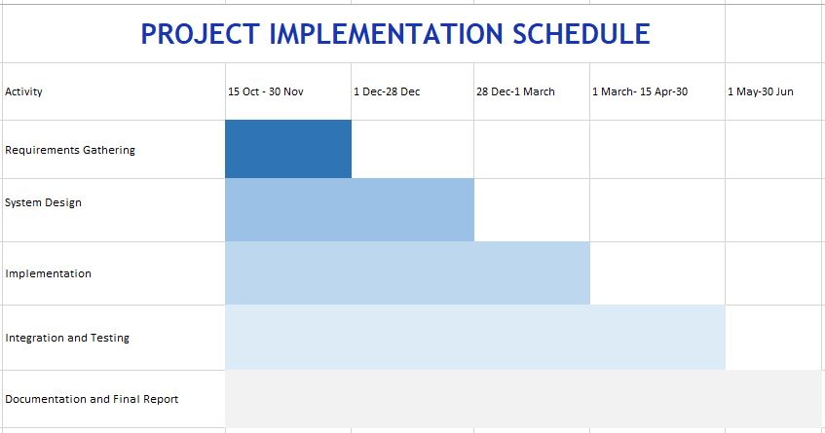

Slide 5
Modules
Hostel Management
Room Allocation
View Room Details
Admin Management
Student Management
Complaint System
Visitor Management
Mess Management
Attendance System
Payment System
Notification System
Notice Board.

Slide 6
Progress

Slide 7
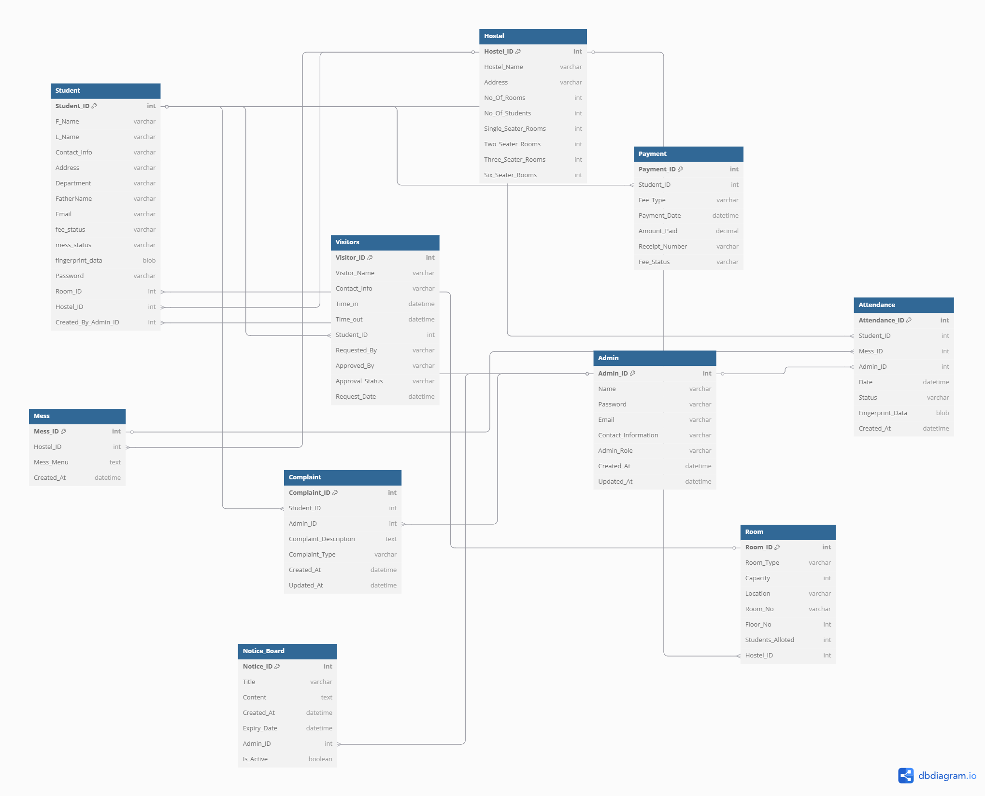
Complete ERD

Slide 8
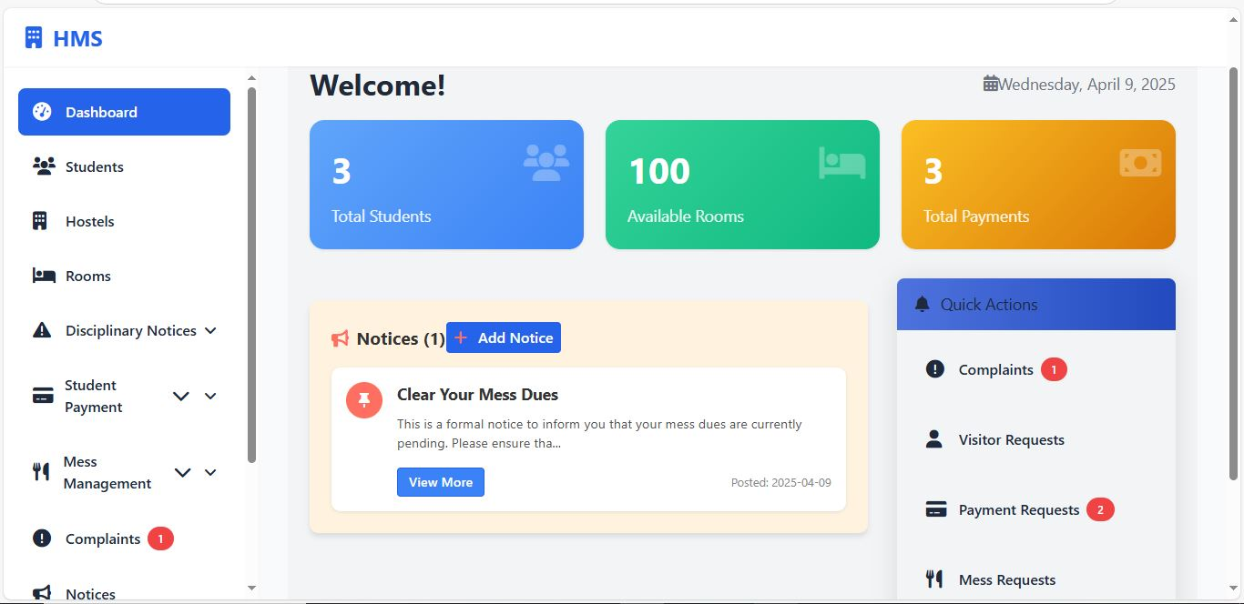
Admin Dashboard

Slide 9
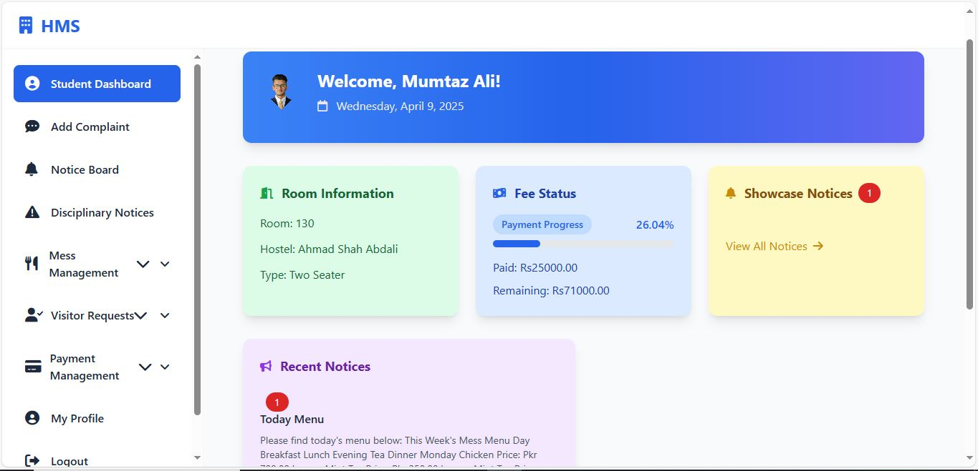
Student Dashboard

Slide 10
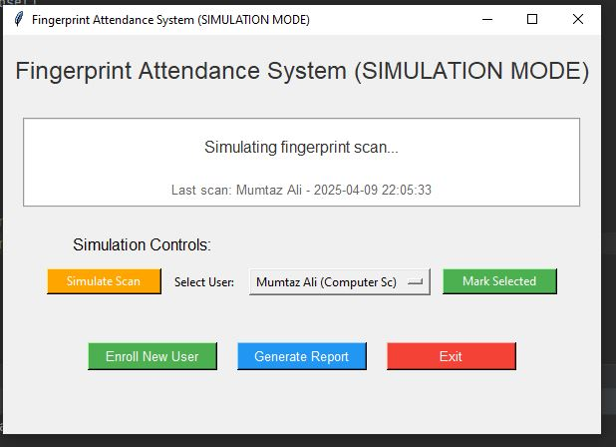
Bio Metric Attendance

Slide 11
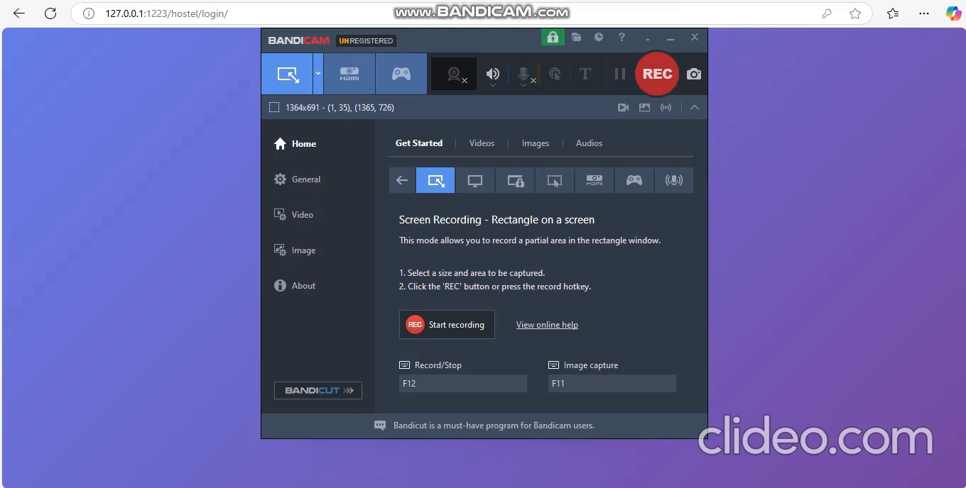
DEMO

Slide 12
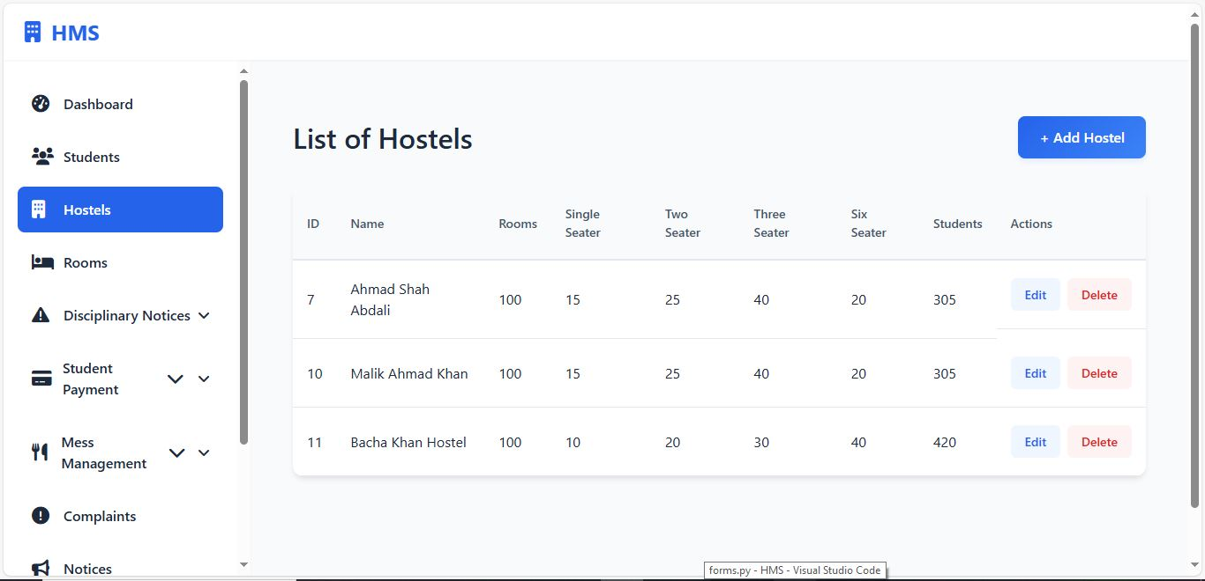
Hostel Management System

Slide 13
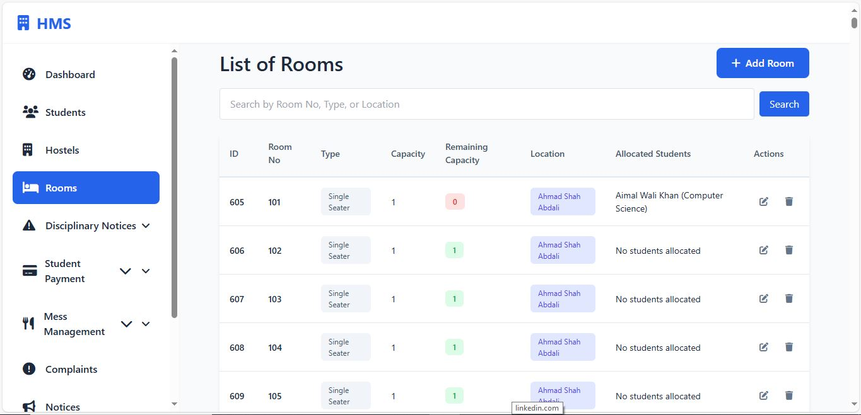
Room Allocations

Slide 14
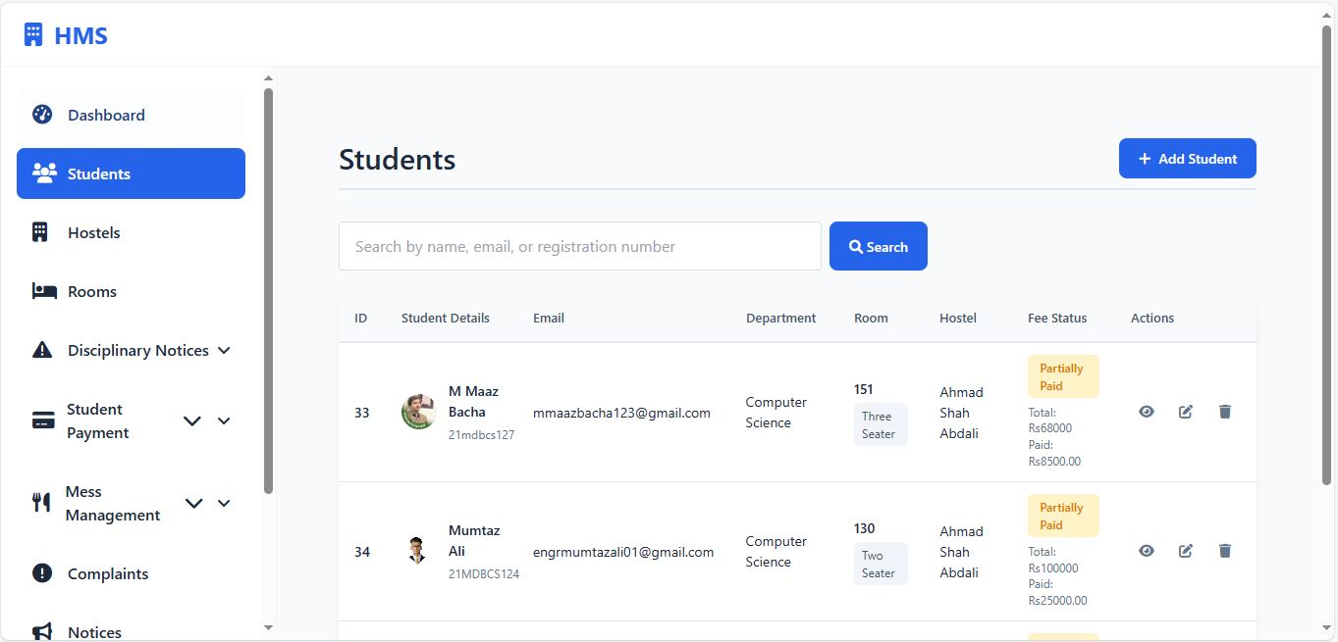
Student Management

Slide 15
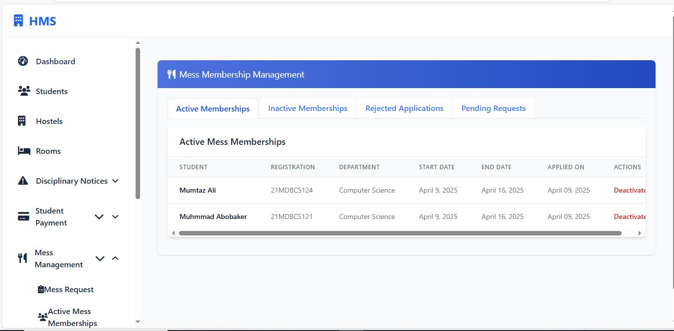
Room Allocations

Slide 16
Thank You!

